Slide 1
Cycle GAN
SAI-S team(season 3) 2nd Paper Review
2020/04/07
Dept. of Computer Engineering, Junior, Jeasung Lee

Slide 2
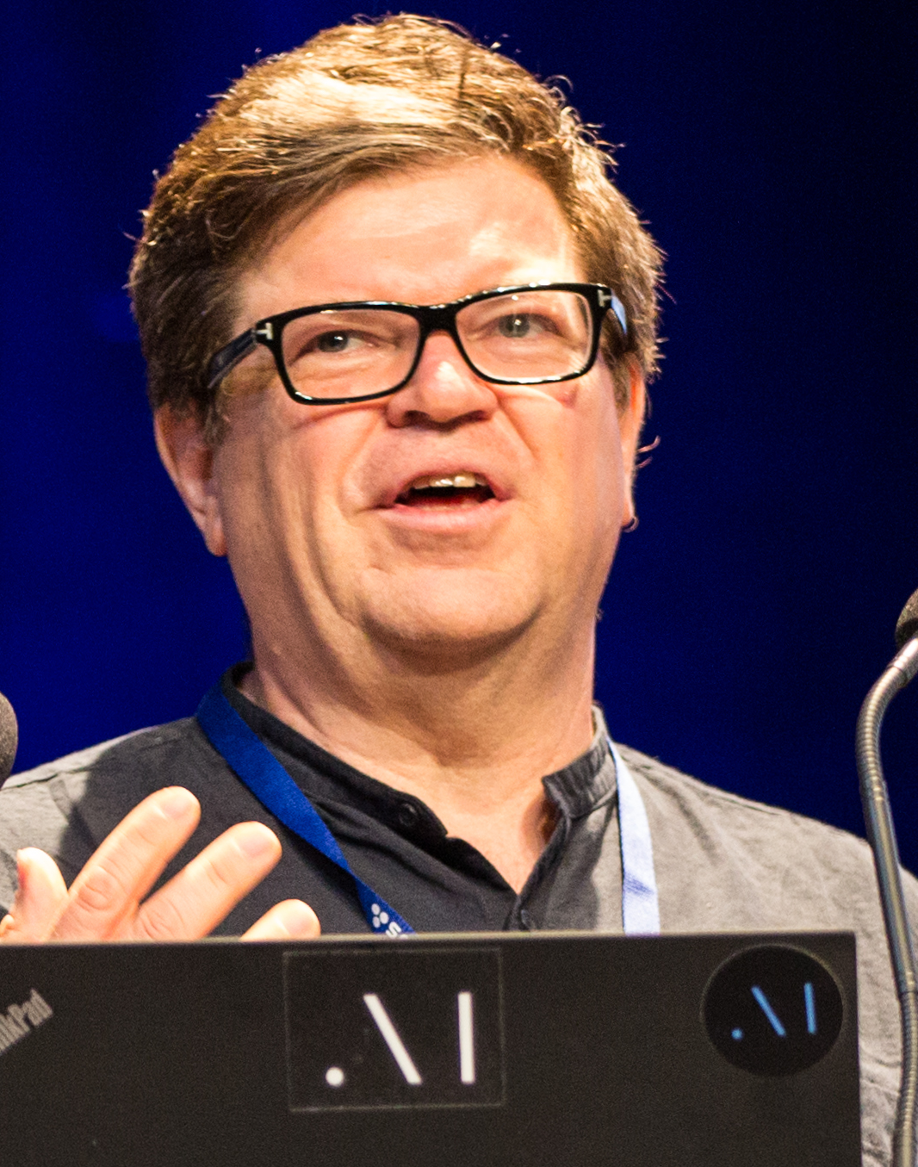
“The coolest idea in deep learning in the last 20 years.” — Yann LeCun on GANs.
Founding Father of ConvNets

Slide 3
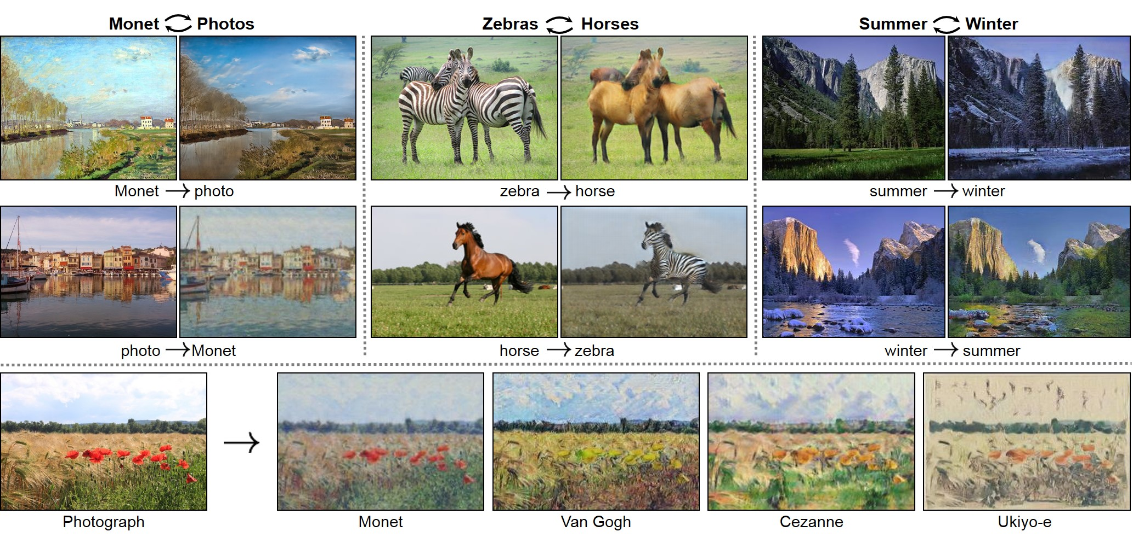
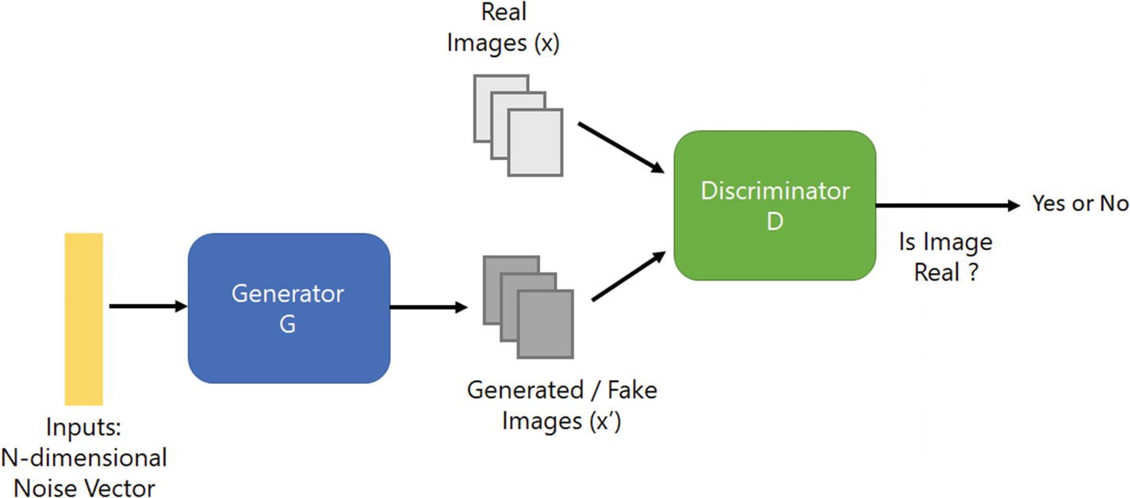
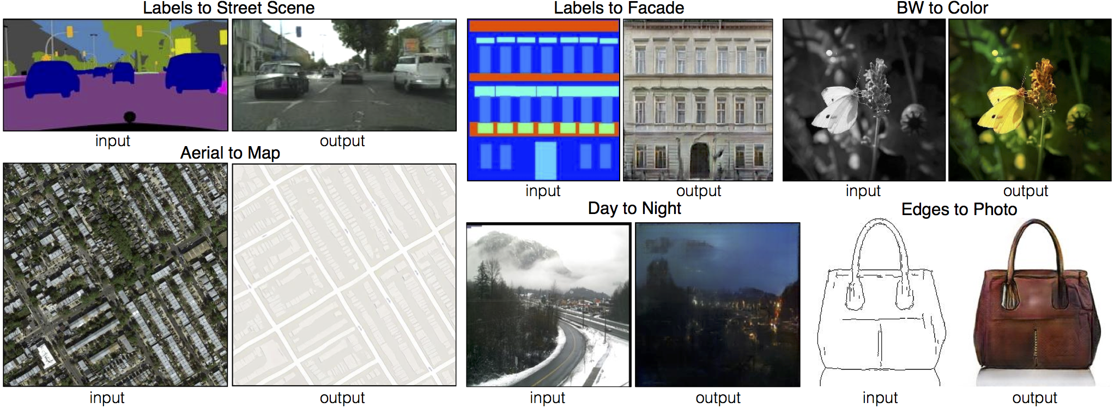
GAN
Pix2Pix
CycleGAN

Slide 4
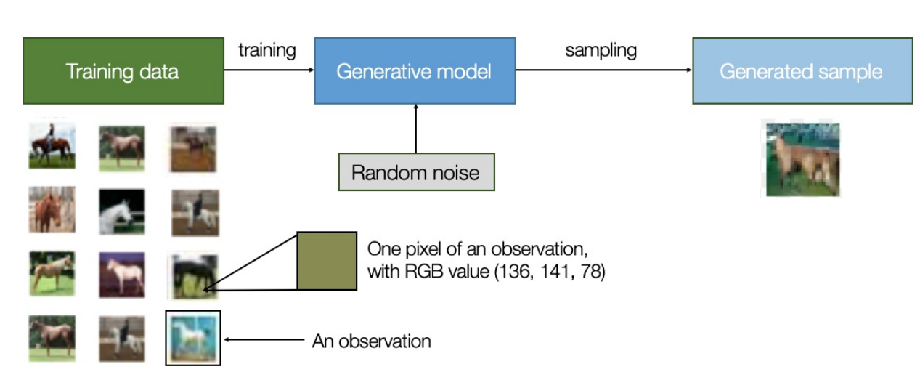
Generative Modeling

Slide 5
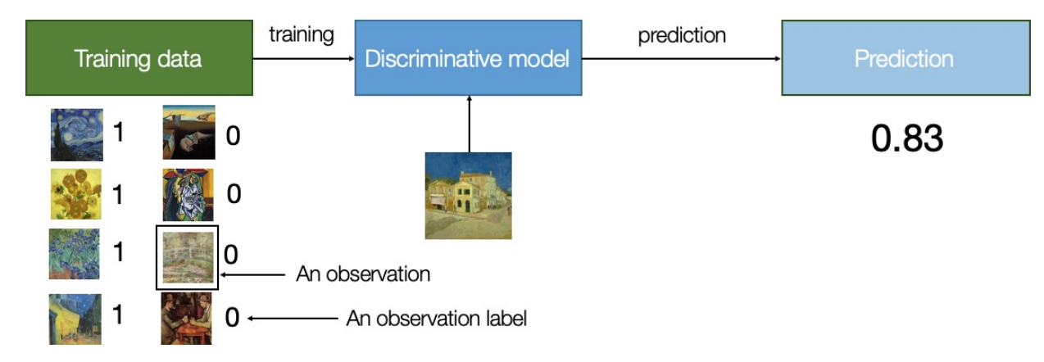
Discriminative Modeling

Slide 6
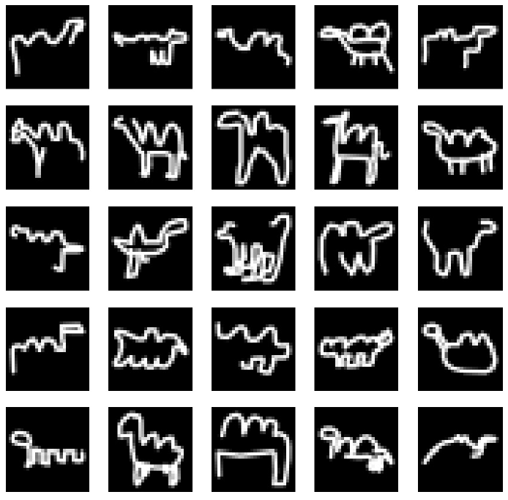
Simple Example

Slide 7
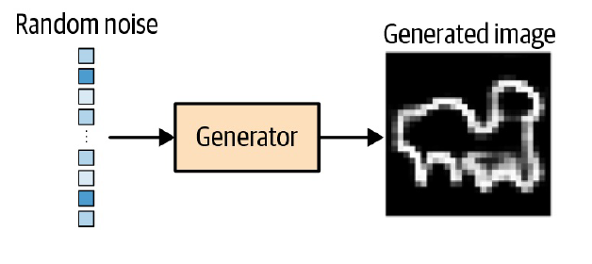
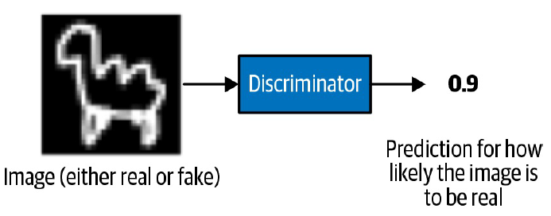

Slide 8
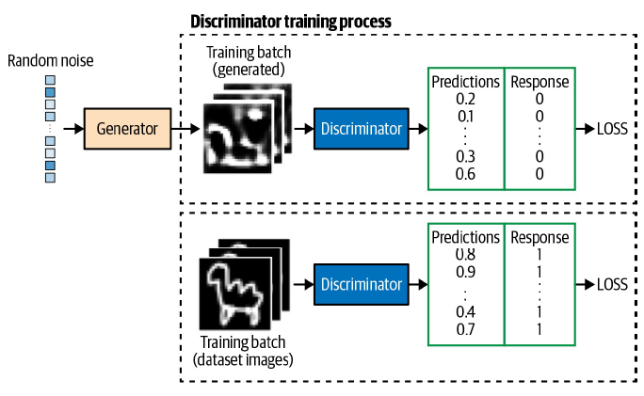
Training Phase(Discriminator)

Slide 9
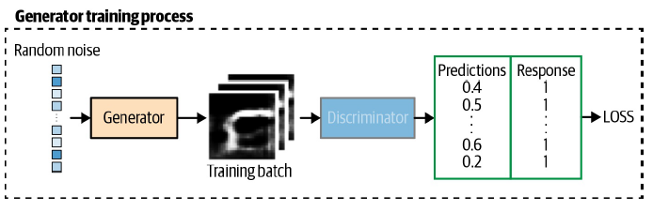
Training Phase(Generator)

Slide 10
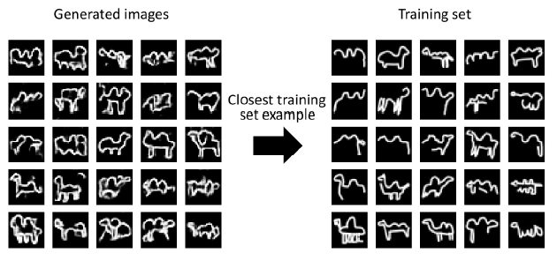
Result

Slide 11
General GAN Architecture

Slide 12
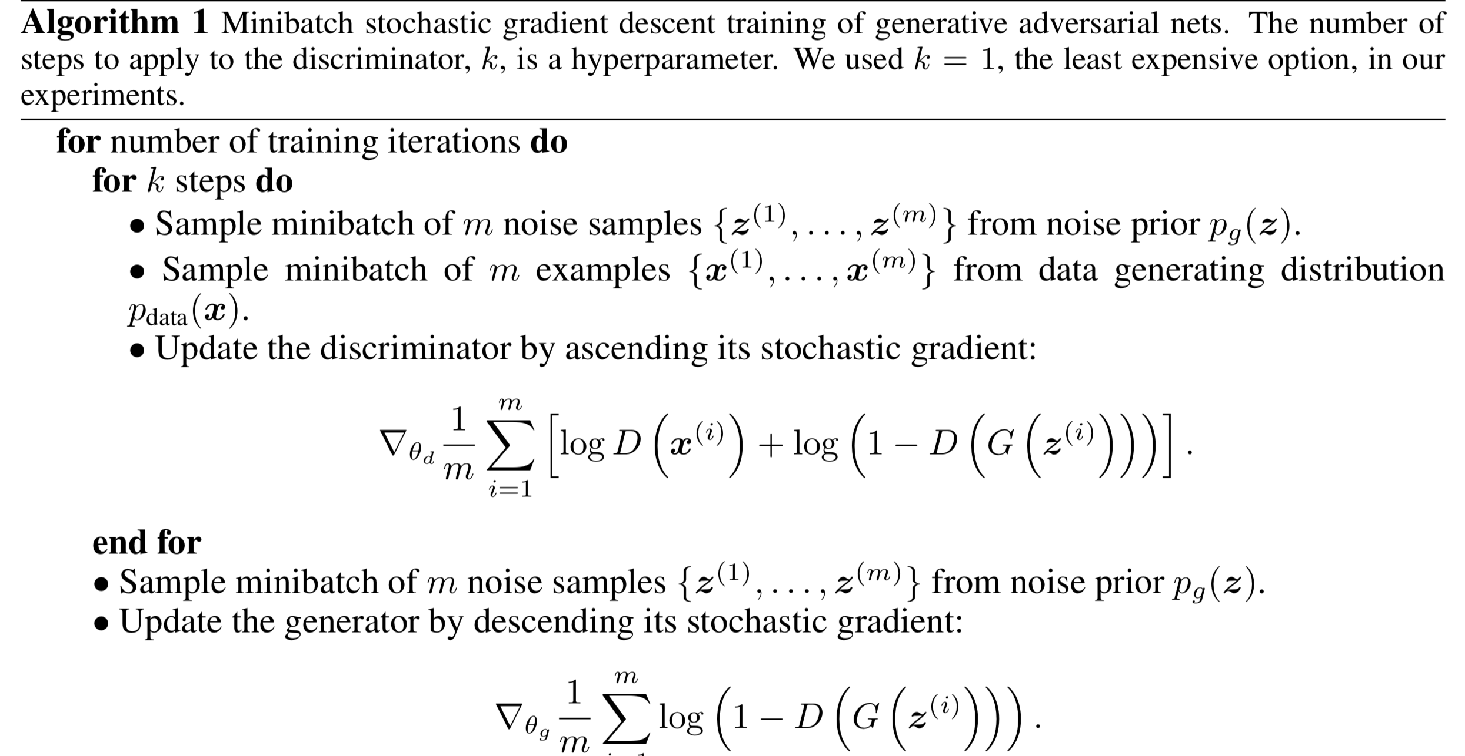

Slide 13
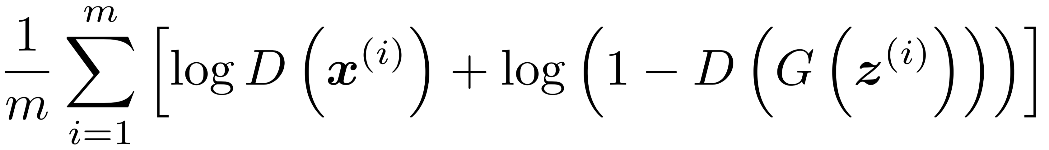
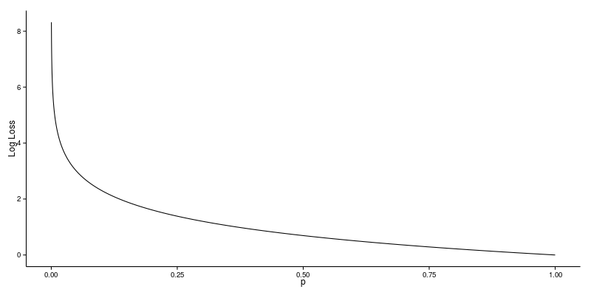
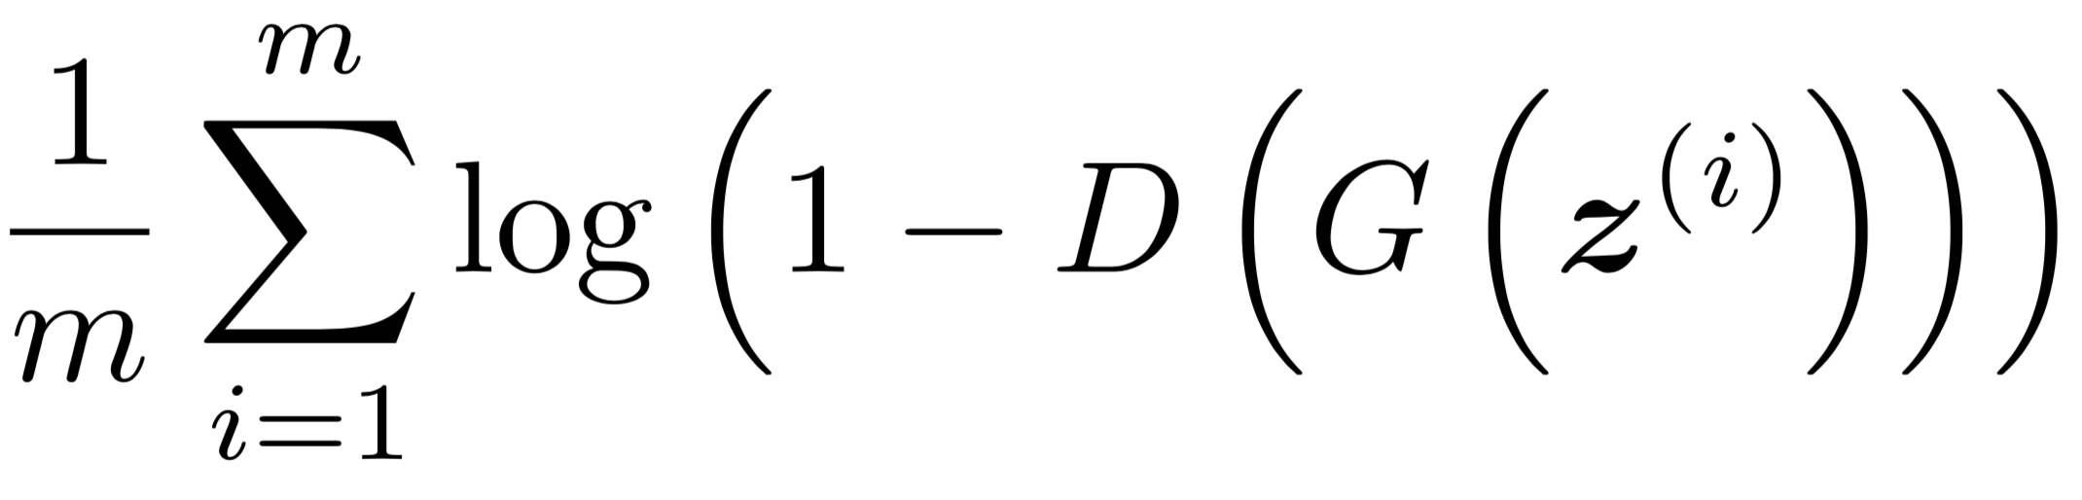
Discriminator
Generator

Slide 14
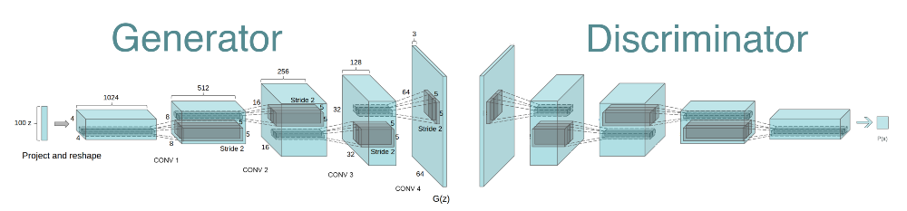
DCGAN Architecture

Slide 15
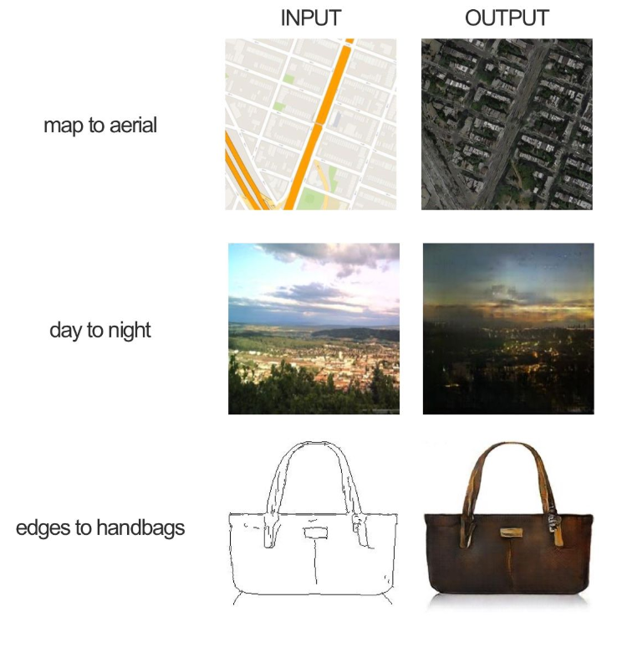
Pix2Pix(Image to Image translation)

Slide 16
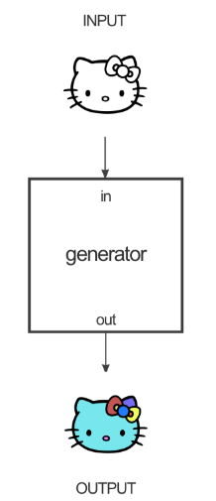
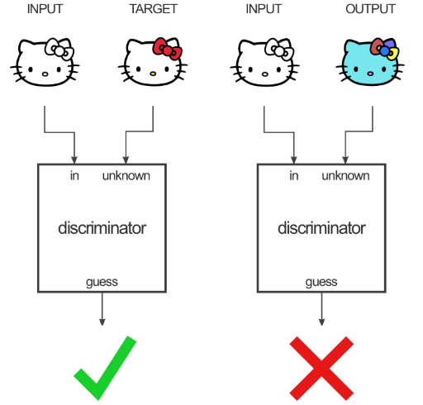
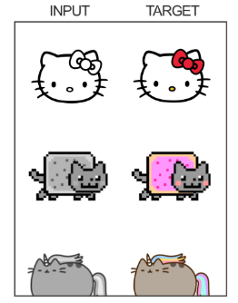
Pix2Pix

Slide 17
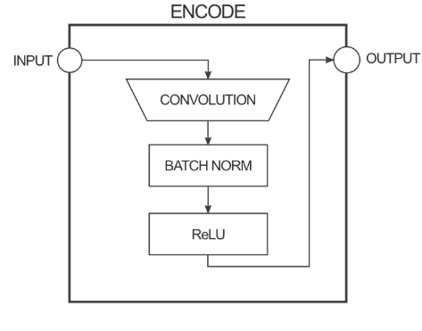
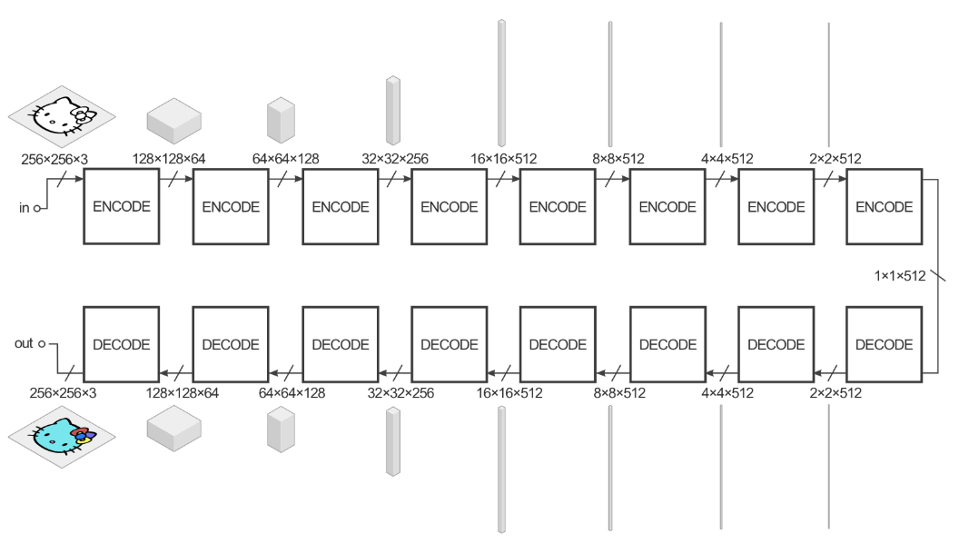
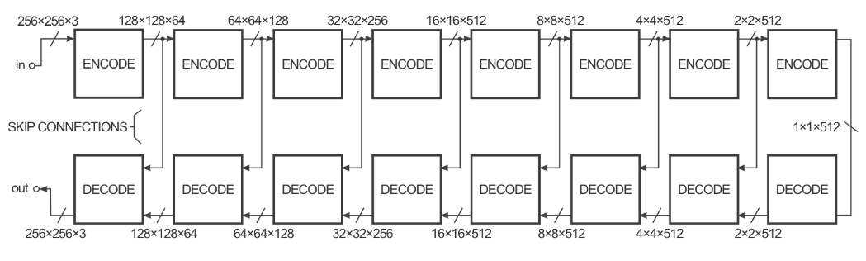
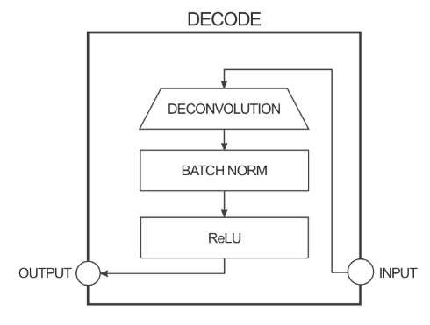
Pix2pix Generator(example)

Slide 18
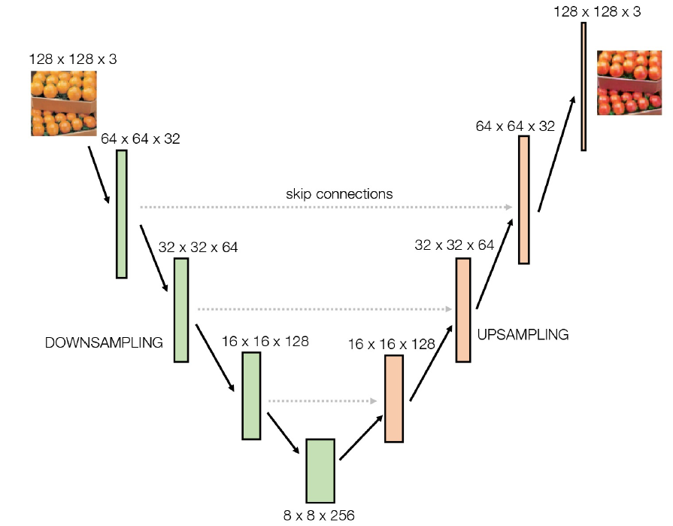
Example U-net

Slide 19
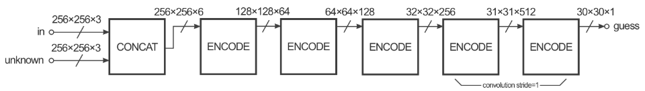
Pix2pix discriminator (example)
PatchGAN
뒤에서~~

Slide 20
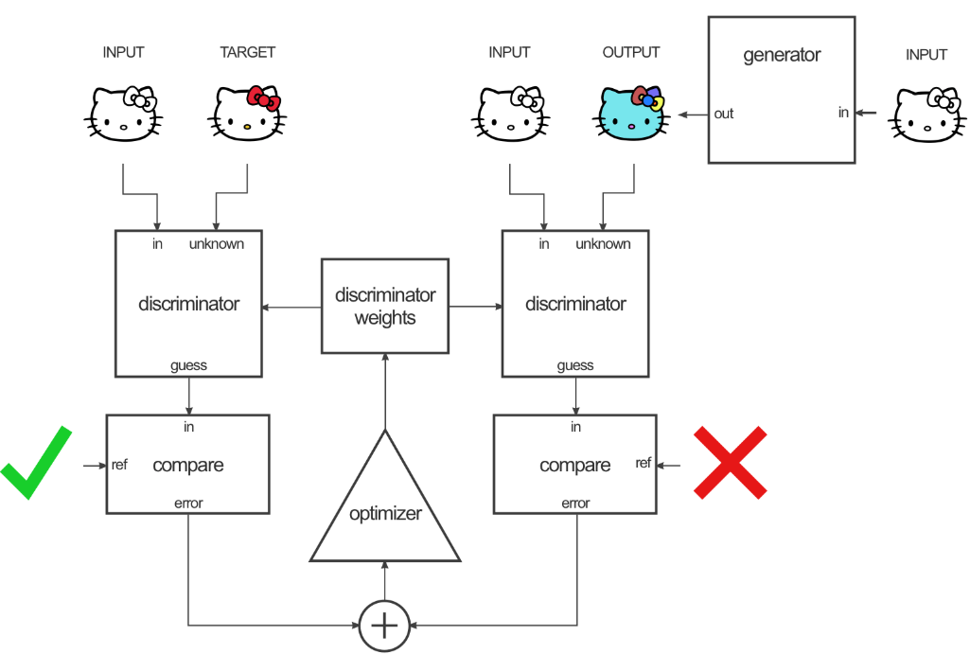
Training Phase(Discriminator)

Slide 21
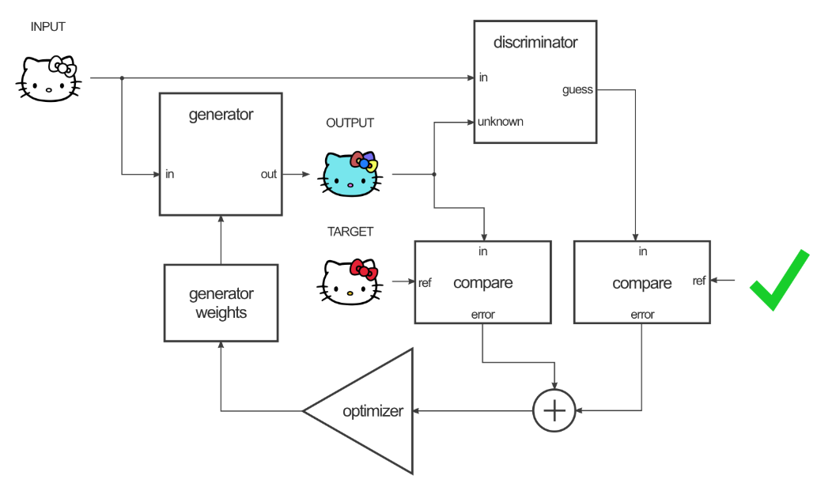
Training Phase(Generator)

Slide 22
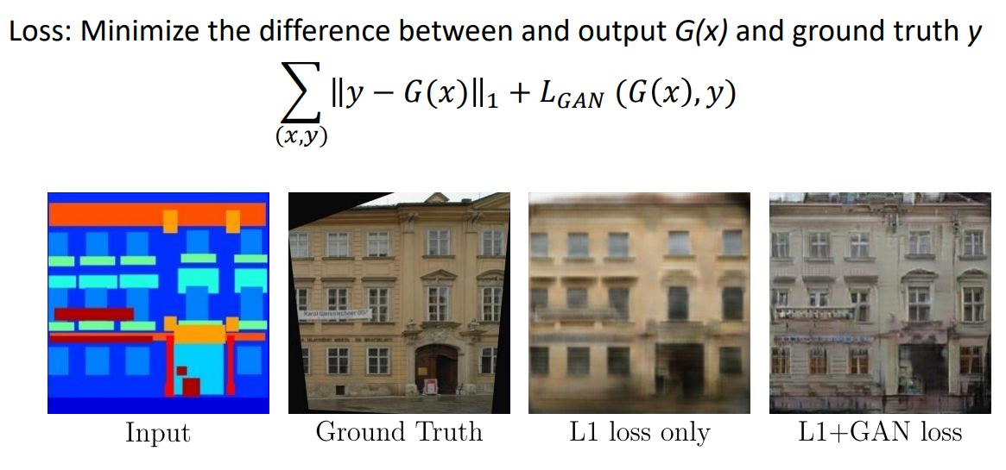

Slide 23
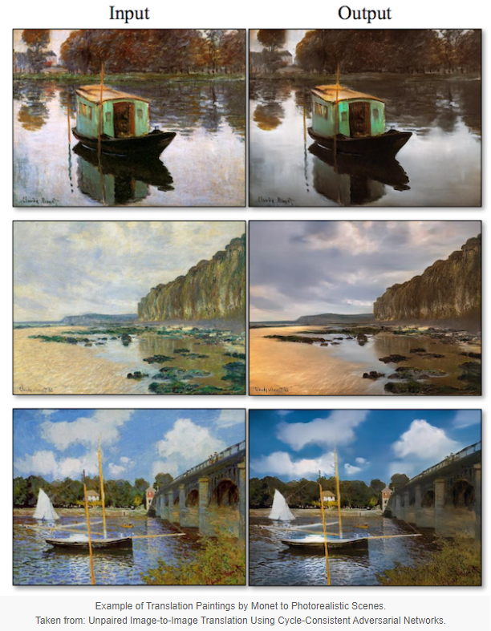
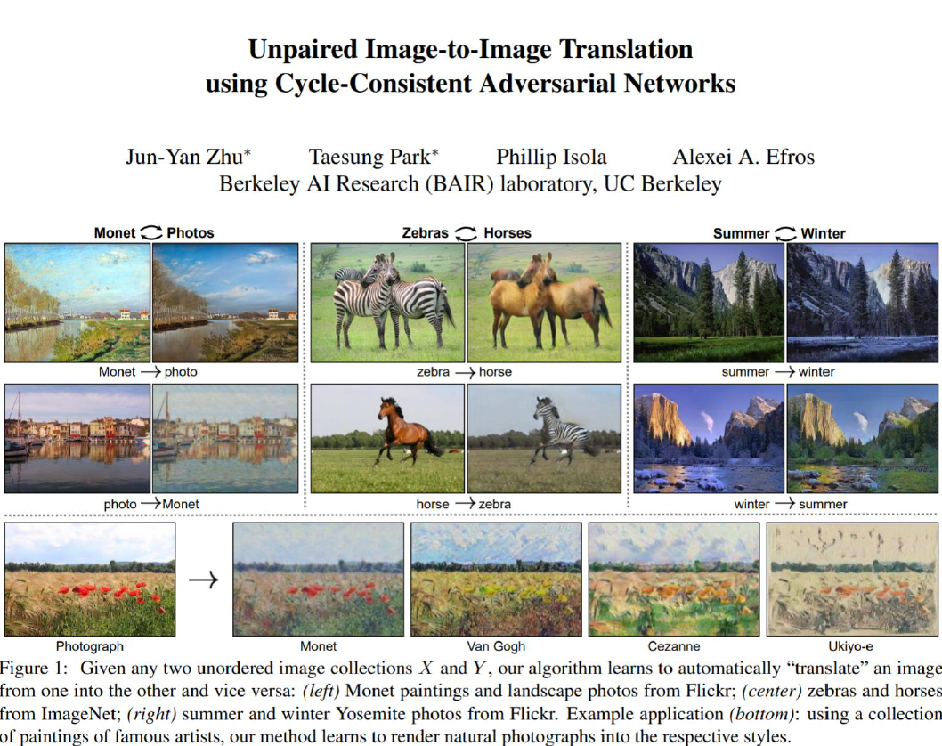
CycleGAN (Unpaired Image to Image Translation)

Slide 24
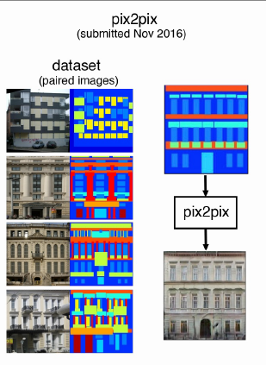
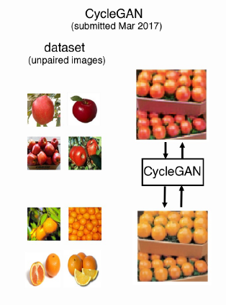
Pix2pix, CycleGAN
DIFF?

Slide 25
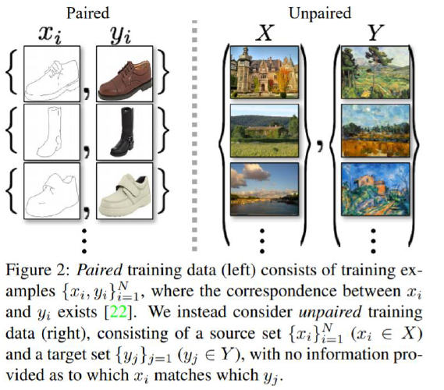
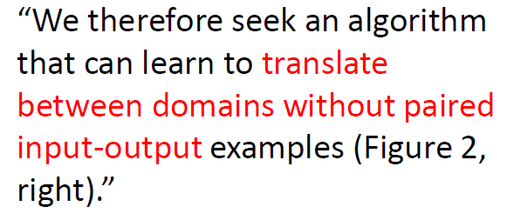

Slide 26
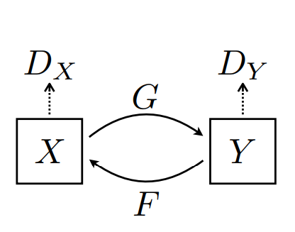
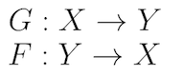
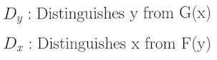

Slide 27
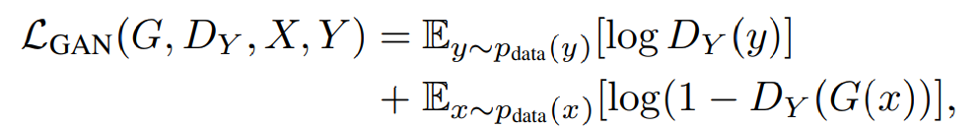
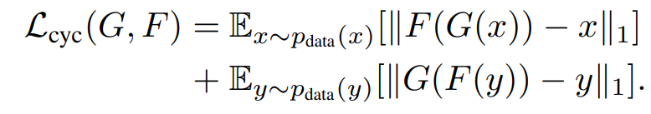
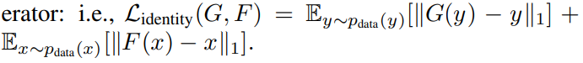
Loss function
(1) Adversarial Loss
(2) Cycle Consistency Loss
(3) Identity Loss
Total Loss for Generator = loss_Generator_X->Y + loss_Generator_Y->X + loss_cycle_X + loss_cycle_Y + loss_idt_A + loss_idt_B
Total Loss for Discriminator = (loss_Discriminator_X + loss_Discriminator_Y)*0.5

Slide 28
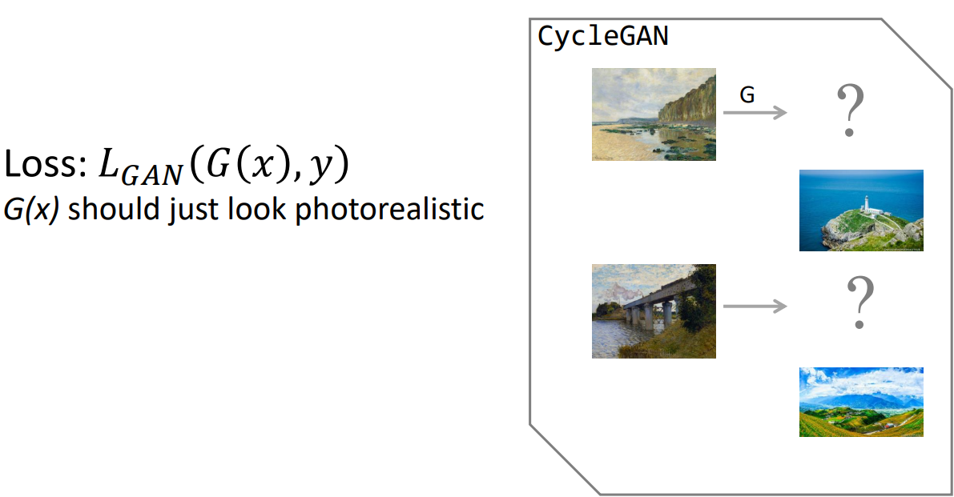
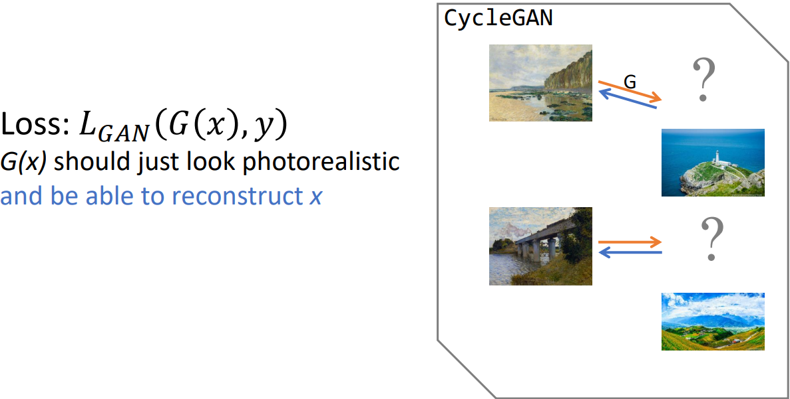

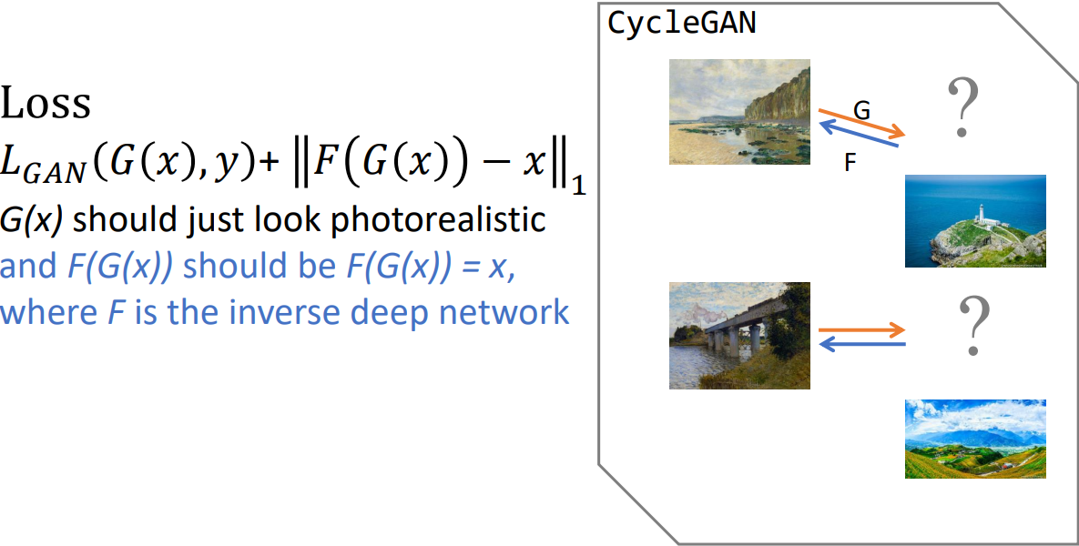
Why need Cycle Loss?
Cyclegan-박태성 (UC Berkeley 박사과정) 에서 사용하신 자료
https://www.youtube.com/watch?v=Fkqf3dS9Cqw

Slide 29
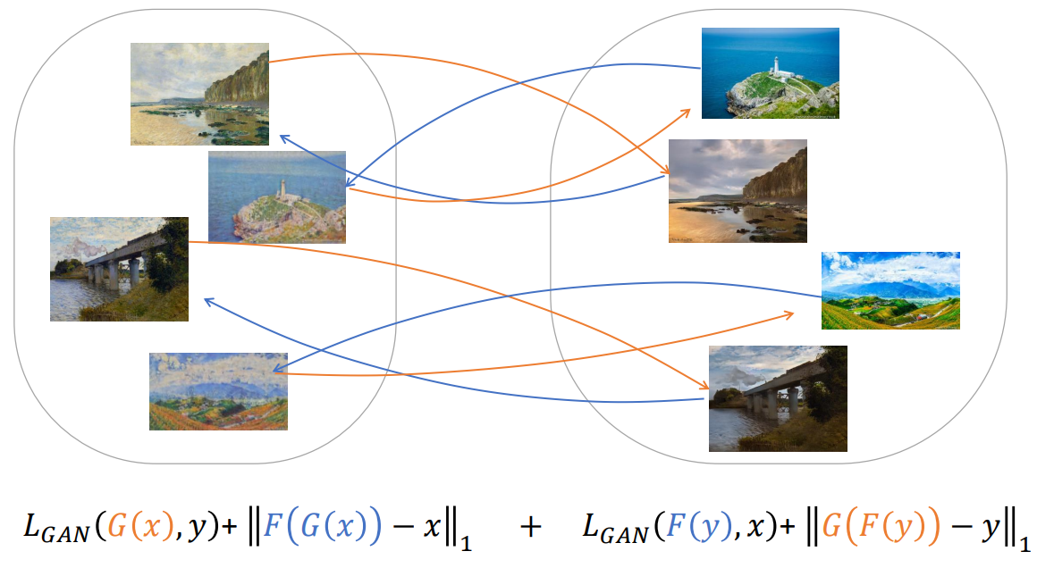
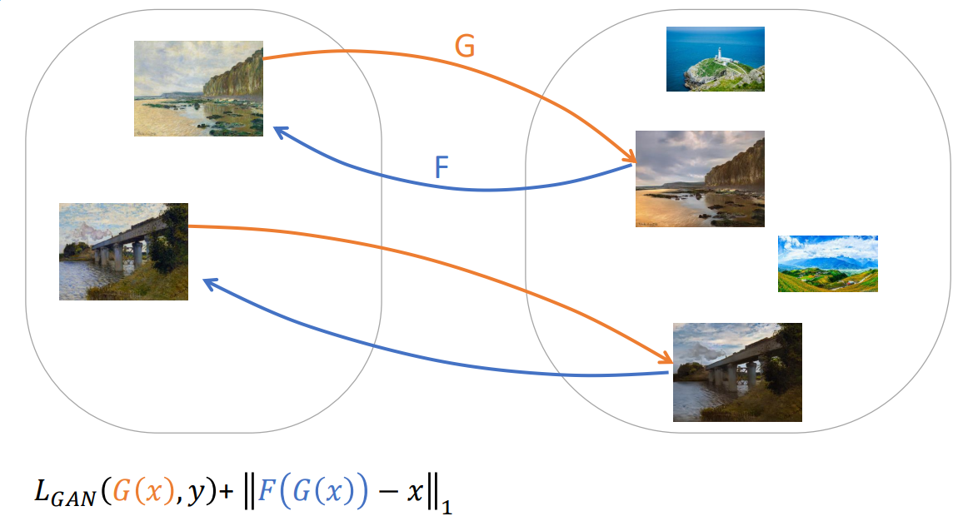
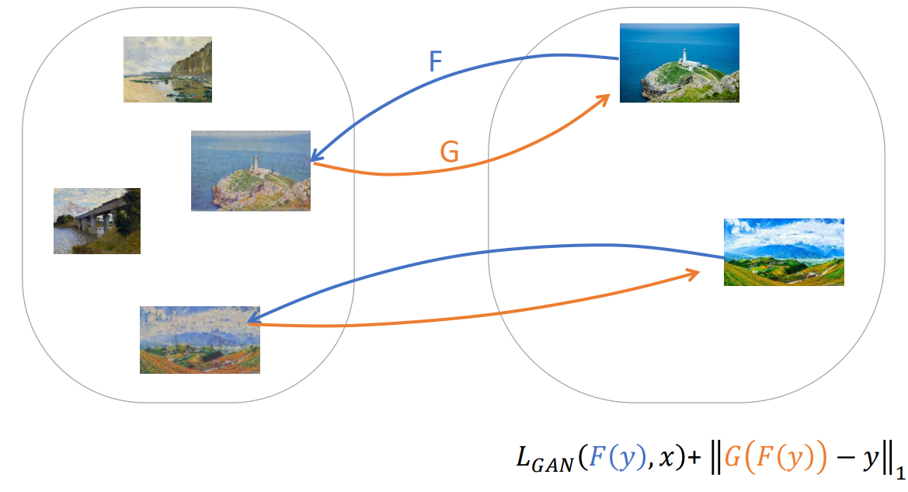
Cyclegan-박태성 (UC Berkeley 박사과정) 에서 사용하신 자료
https://www.youtube.com/watch?v=Fkqf3dS9Cqw

Slide 30
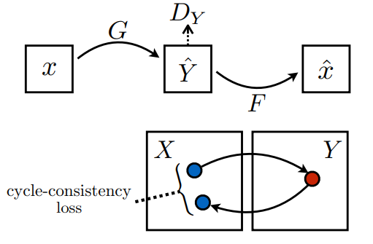
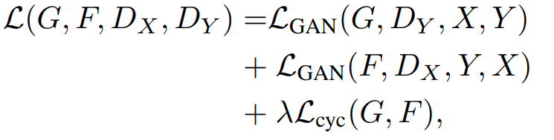


Full Objective

Slide 31



Network Architecture

Slide 32


Discriminator (Example)
Generator(Example)

Slide 33


Example Generator

Slide 34

Instance Normalization?
PatchGAN?

Slide 35

Normalization Techniques

Slide 36


PatchGAN

Slide 37



Slide 38



Slide 39


Slide 40


Slide 41


Slide 42


Slide 43


Slide 44
Reference
Generative Deep Learning(O’relly) – David Foster
https://affinelayer.com/pix2pix/
https://arxiv.org/pdf/1703.10593.pdf
https://junyanz.github.io/CycleGAN/
https://www.slideshare.net/NaverEngineering/finding-connections-among-images-using-cyclegan
https://towardsdatascience.com/cyclegan-learning-to-translate-images-without-paired-training-data-5b4e93862c8d

